Slide 1

Loan modelling

Slide 2

AGENDA
1. Introduction
2. Dataset Overview
3. Data Preprocessing
4. Exploratory Data Analysis
5. Modeling & Evaluation
6. Key Insights
7. Communication Impact
8. Conclusion

Slide 3

Dataset overview

Slide 4
Project Overview: Loan Modelling
What is Loan Modeling?
Briefly explain the concept: Using data to predict the likelihood of loan repayment or identify optimal lending strategies.
Our Objective:
(State your specific objective here, e.g., To build a model that predicts customer loan default, or to analyze customer data to identify potential loan candidates.)

Slide 5
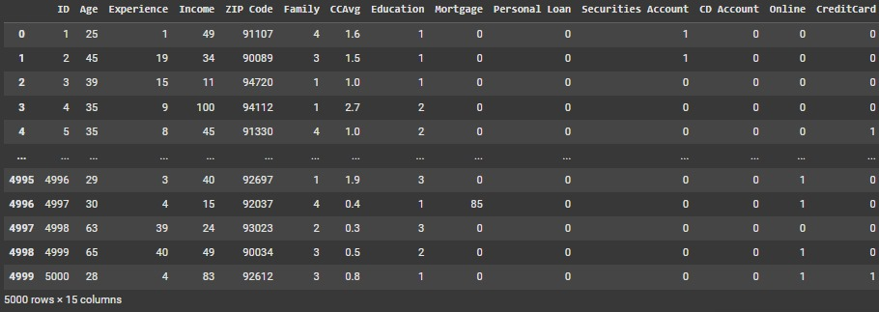
Dataset structure
1.Source: Bank Personal Loan Modelling Dataset
2.Features: Age, Income, Experience, Family Size, Education, CCAvg, Mortgage,securities account,cd account, online ,creditcard
3.Target: personal loan

Slide 6
Exploratory Data Analysis
ENHANCING YOUR PRESENTATION

Slide 7
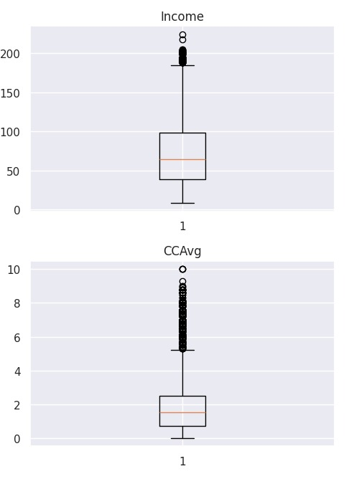
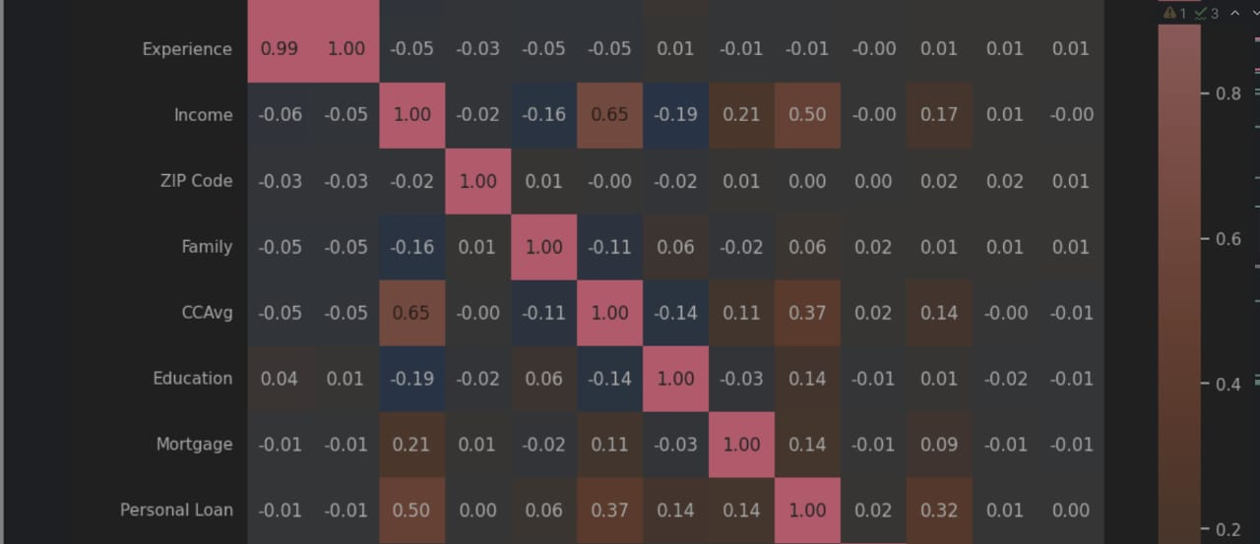
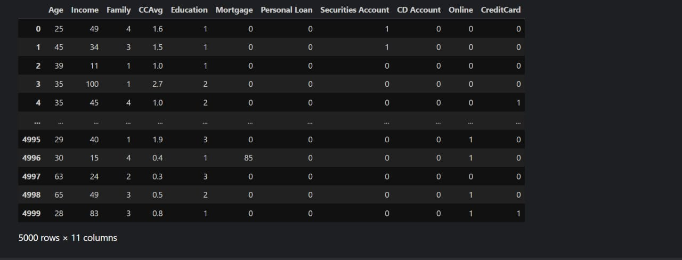
Data Preprocessing Pipeline
Workflow: (Consider a simple flowchart visual for this slide)
Handling Missing Values & Duplicates
Data Type Correction & Feature Selection
Outlier Detection & Treatment
Correlation Analysis
Feature Engineering / Scaling (if applicable)
Handling Class Imbalance (e.g., SMOTE)

Slide 8
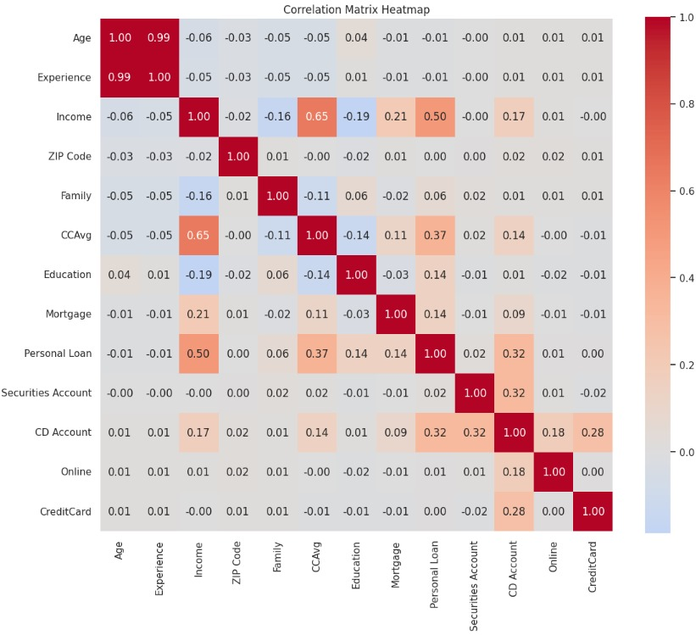
correlation
• Use correlation matrix to identify related features
• Remove 'Experience' due to high correlation with 'Age'

Slide 9
Visualizations based on thoughtful questions

Slide 10
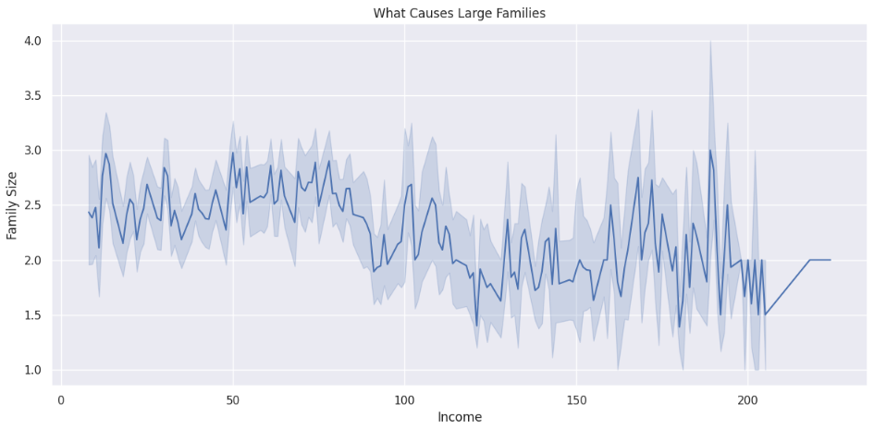
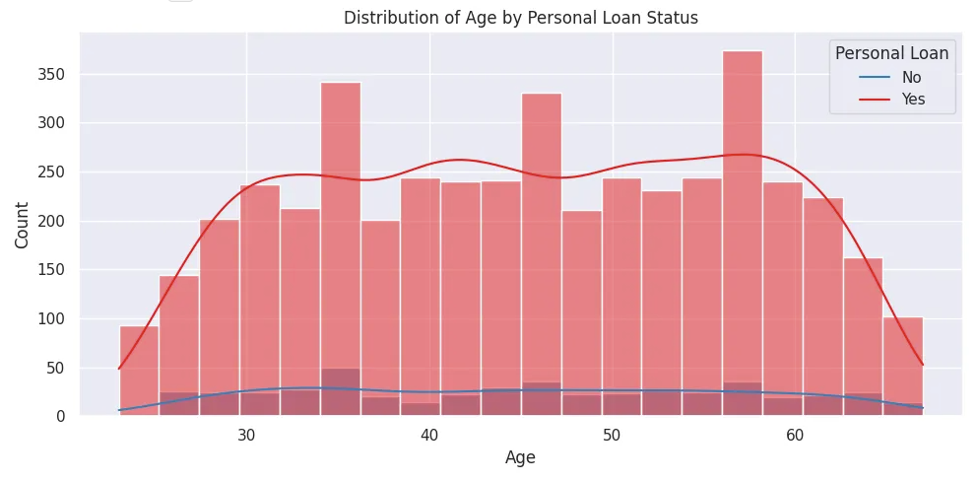
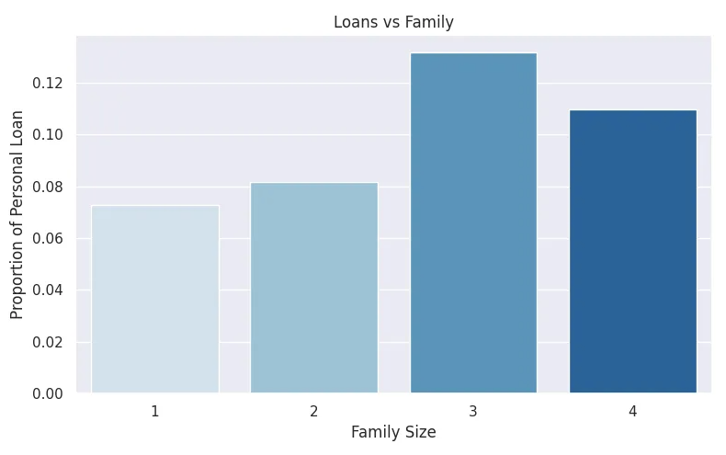

Slide 11
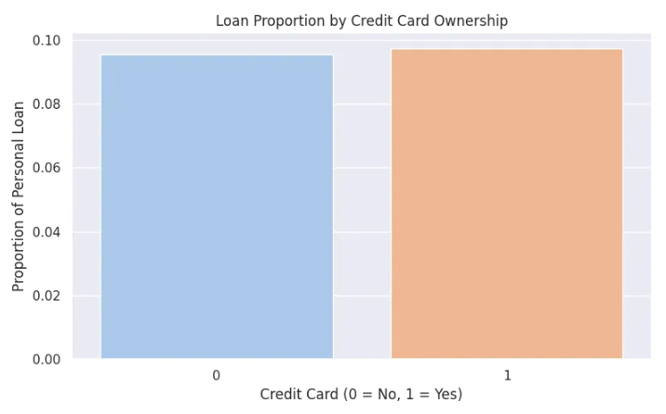
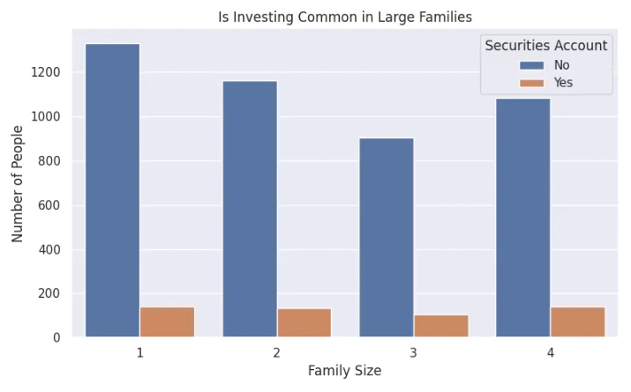
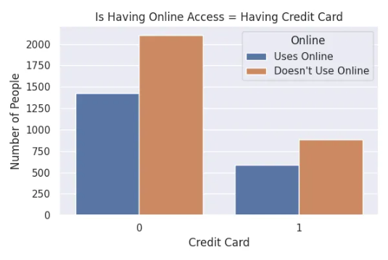

Slide 12
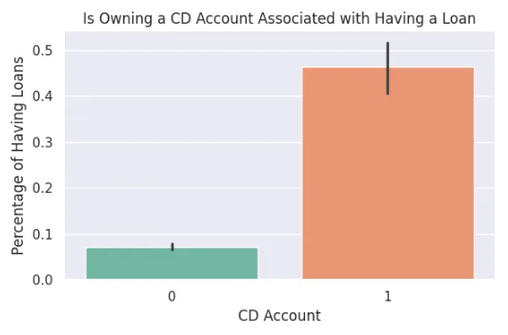
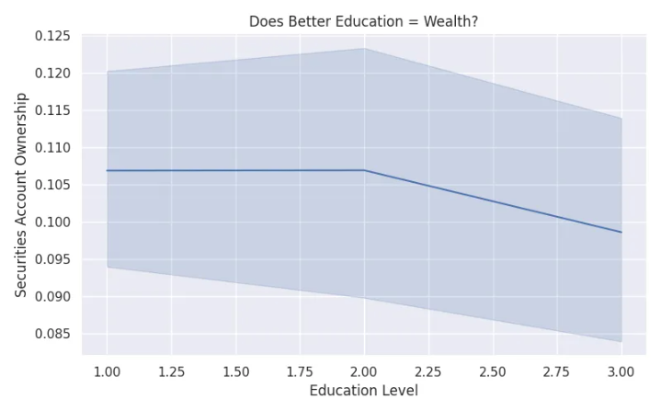
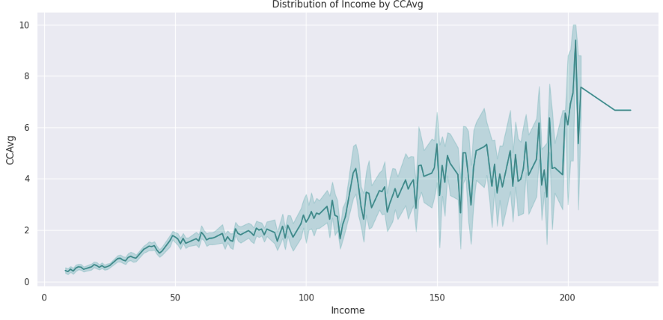

Slide 13
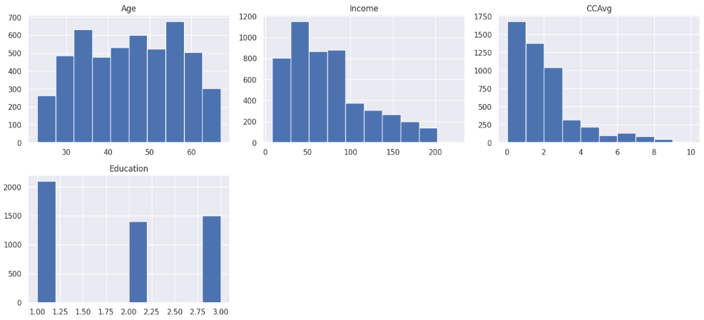
visuals the columns checking for balancing and scaling

Slide 14
Scaling & balancing

Slide 15
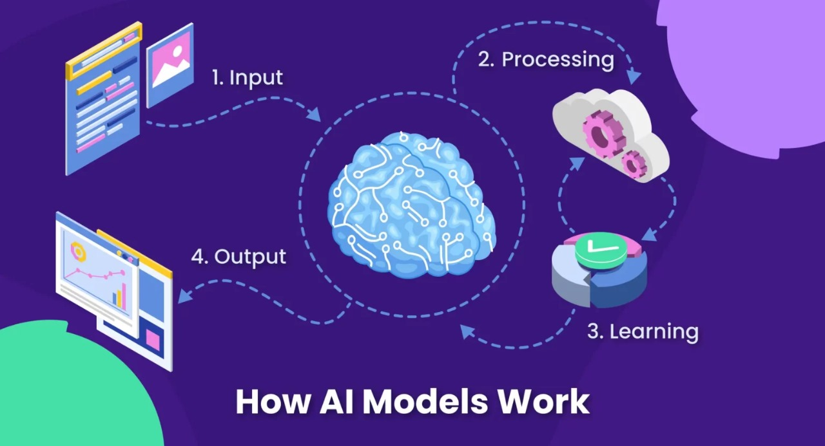
• Split data (Train/Test)
• Apply models: Logistic Regression, Random Forest, SVM
• Evaluate using Accuracy, Precision, Recall, F1-Score
• Use GridSearchCV for hyperparameter tuning

Slide 16
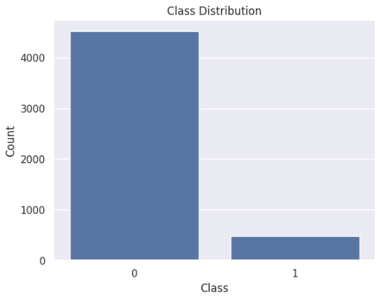
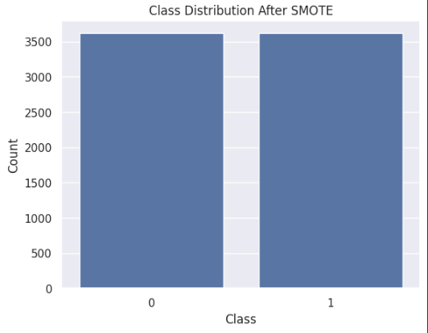
Handling Class Imbalance
Detected class imbalance in the target variable. Applied SMOTE (Synthetic Minority Over-sampling Technique) to generate synthetic samples for the minority class.
This method was selected based on the data distribution and its effectiveness in improving model performance

Slide 17
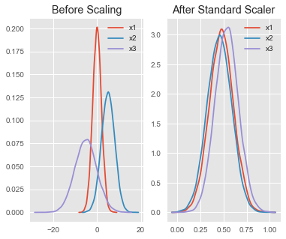
scalling
Used StandardScaler from sklearn.preprocessing.
Standardizes features by removing the mean and scaling to unit variance.
Helps improve performance of distance-based models like KNN and SVM.
Ensures all numerical features are on the same scale.
Applied scaling after splitting data to avoid data leakage.
Important for algorithms sensitive to feature magnitude.

Slide 18
Models

Slide 19
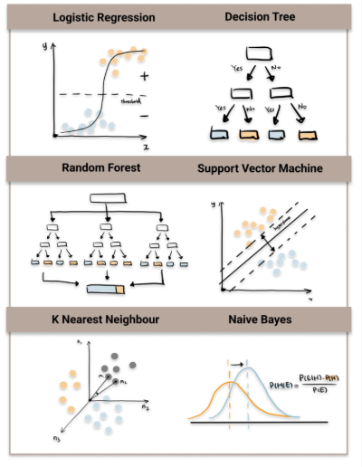
Models
Logistic Regression:
Tuned C, solver, and penalty.
Random Forest:
Tuned n_estimators, max_depth, min_samples_split.
K-Nearest Neighbors (KNN):
Tuned n_neighbors and weights.
Support Vector Machine (SVM):
Tuned C, kernel, and gamma.

Slide 20
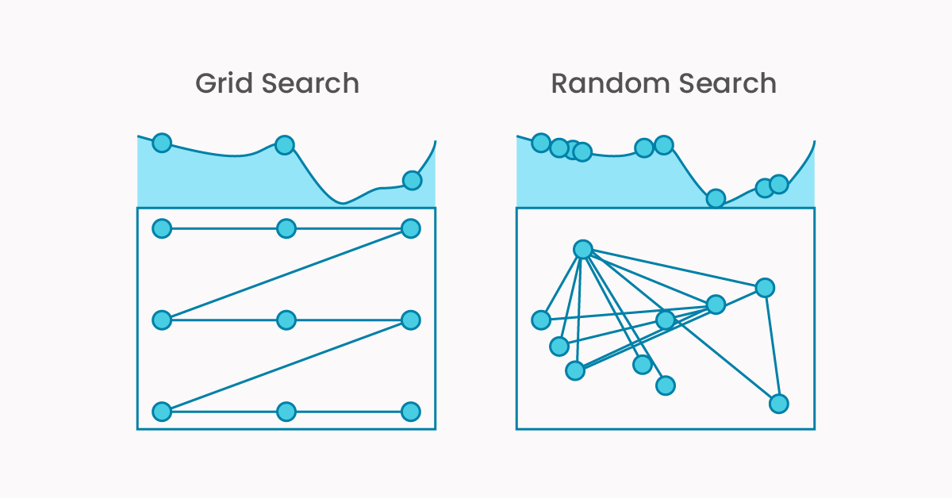
Models
Decision Tree:
Tuned max_depth and min_samples_split.
Naive Bayes:
No tuning needed (GaussianNB is parameter-free).
XGBoost:
Tuned n_estimators, max_depth, learning_rate.
Tuning Approach: GridSearchCV
Used GridSearchCV for systematic hyperparameter tuning.
Performed cross-validation to avoid overfitting.
Best parameters were selected based on validation accuracy.

Slide 21
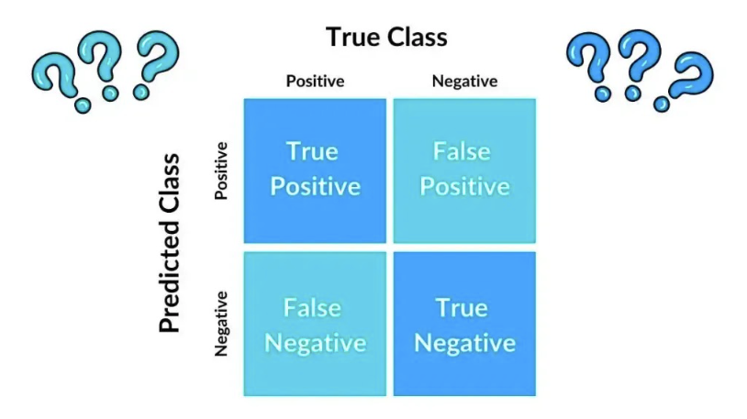
Confusion Matrix & Metrics
• Visualize confusion matrix with Seaborn
• Calculate metrics: Accuracy, Precision, Recall, F1
• Discuss true/false positives and negatives

Slide 22
Deployment

Slide 23
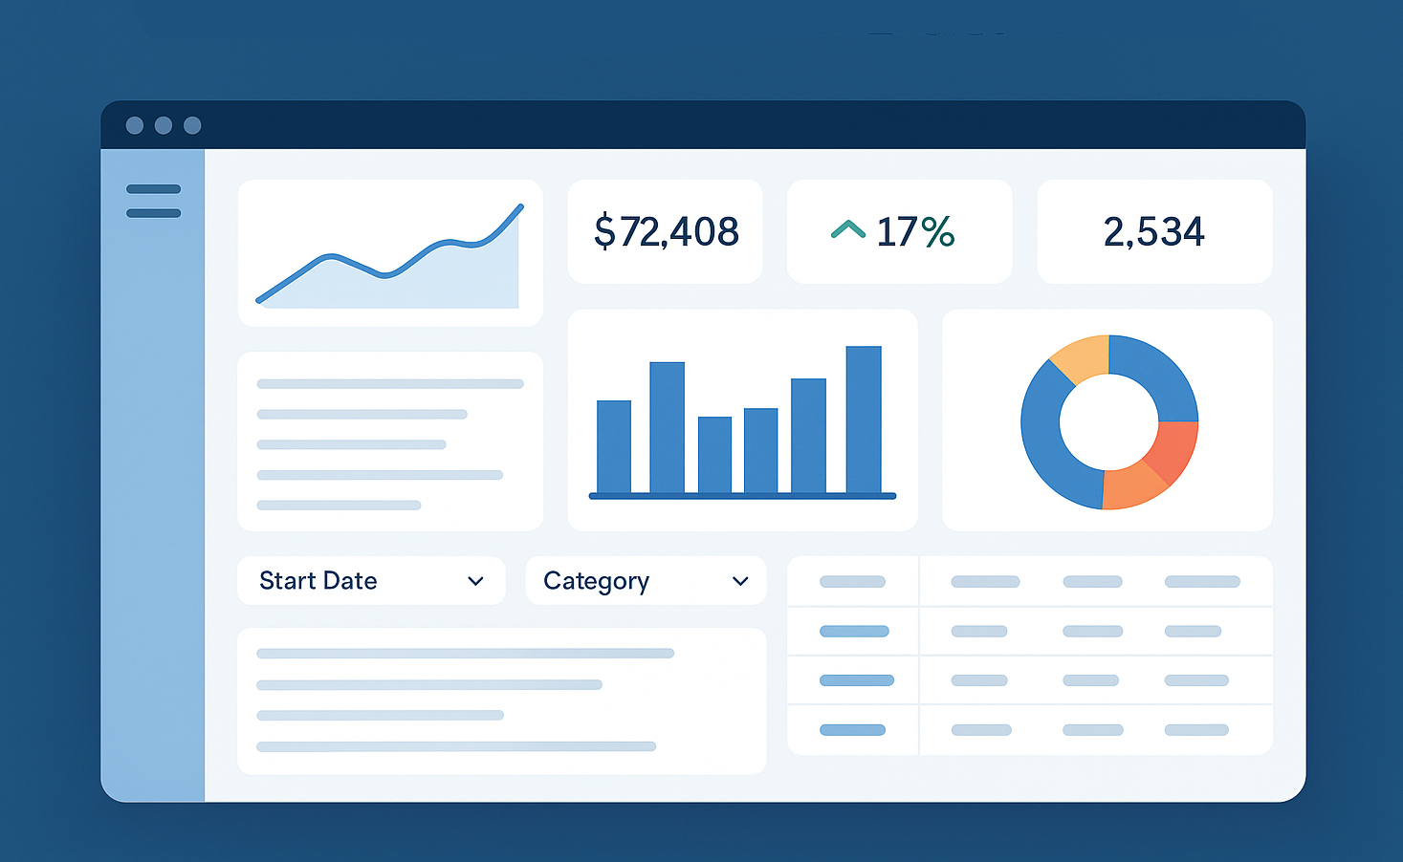
dashboard

Slide 24
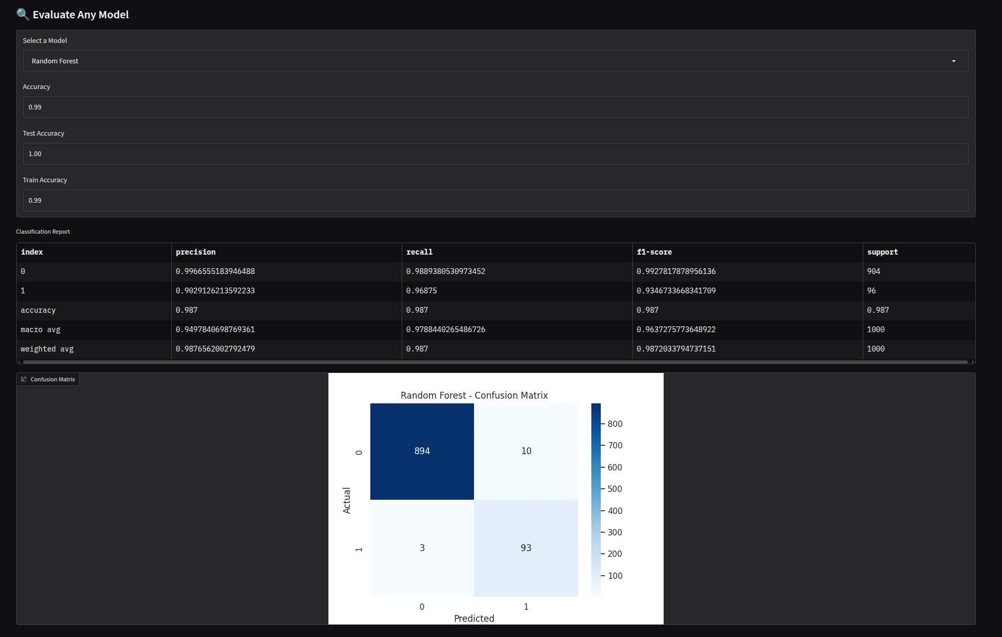

Slide 25

THANK YOU

